Slide 1
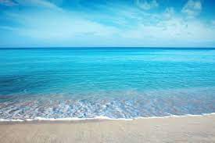
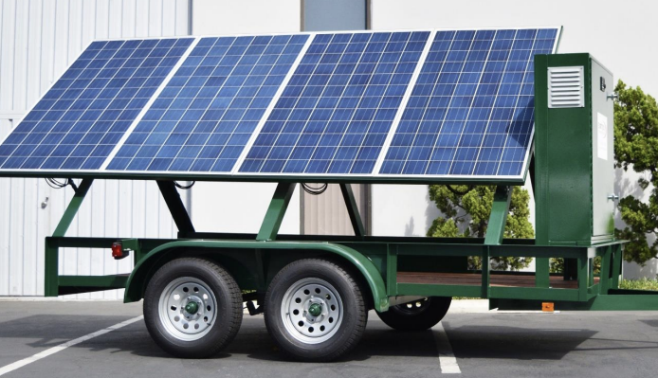
WaterFaire
Introducing
Water From Air Technology
Provides Water Insurance Solutions to the Global Water Shortage.
Applies to household, garden, drinking, and special use water needs
By: WaterFaire Enterprises

Slide 2
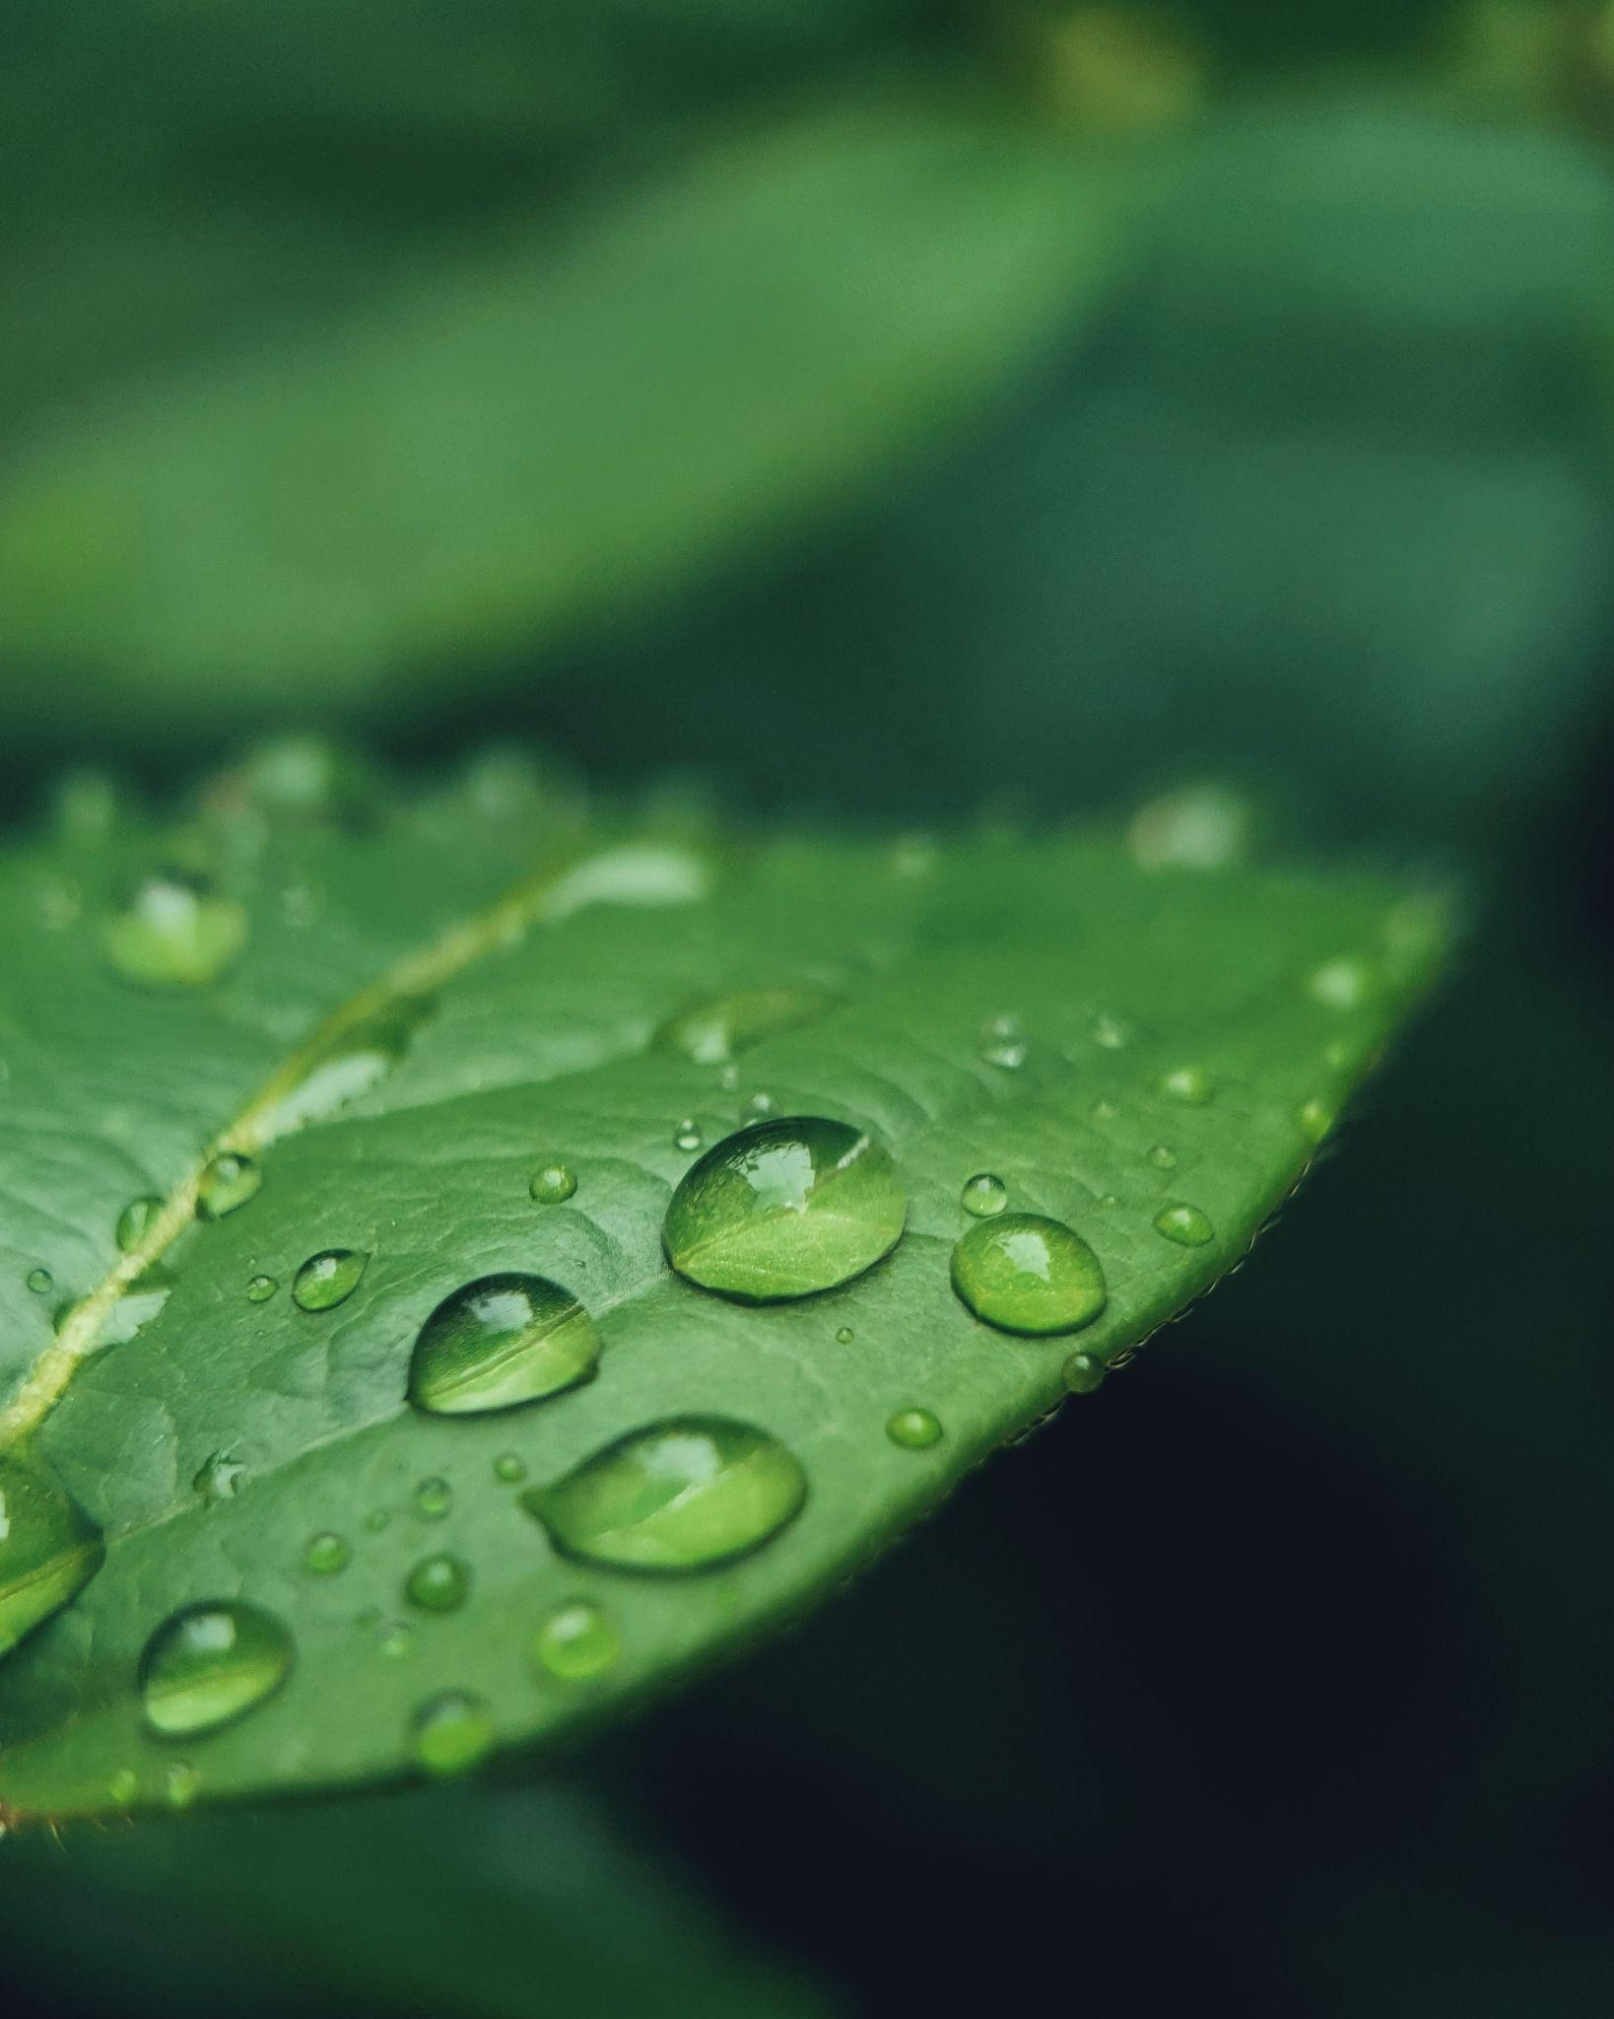
WaterFaire Solves Fresh Water Supply Needs
Requirements:
Proximity to an ocean 100-150 miles away, or large body of water 10-20 miles away.
Atmospheric water is available, even in deserts like Northern Africa and the Middle East, when close to Ocean. See global dew point map link page 11.
Water From Air technology by WaterFaire provides an efficient, economical way to collect water from the atmosphere for home and personal use, as well as yard and garden irrigation. Our proprietary added potable drinking water unit adds the steps to assure safe drinking water for the entire family.
Water from air technology saves running expensive irrigation lines from main water lines to isolated garden areas, which opens up for growing on otherwise unusable land.
This can scale to apply to: parks, public/private retreats, remote homesteads, and recreation as well as natural preserve areas away from local water utility connections.
In Global Drought Regions or as backup for nations with inadequate reserves, WaterFaire ‘s technology assures secure water in multiple applications where needed.

Slide 3
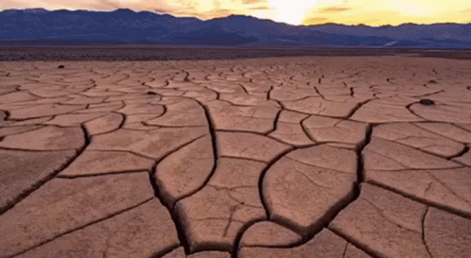
Drought & Disaster Relief
WaterFaire can be rapidly deployed where drought & disasters demand fresh water be made available for populations requiring ongoing basic fresh water supplies in a hurry. This is an economical way to address otherwise ongoing required shipments as one WaterFaire unit can produce 20 - 80 plus gallons of water per day saving that much daily transport of back up water in emergencies. The solar power option is key to this application’s use as well, with solar power being able to also be used for additional emergency applications. Battery backup assures evening water production additional to the daylight solar power.

Slide 4
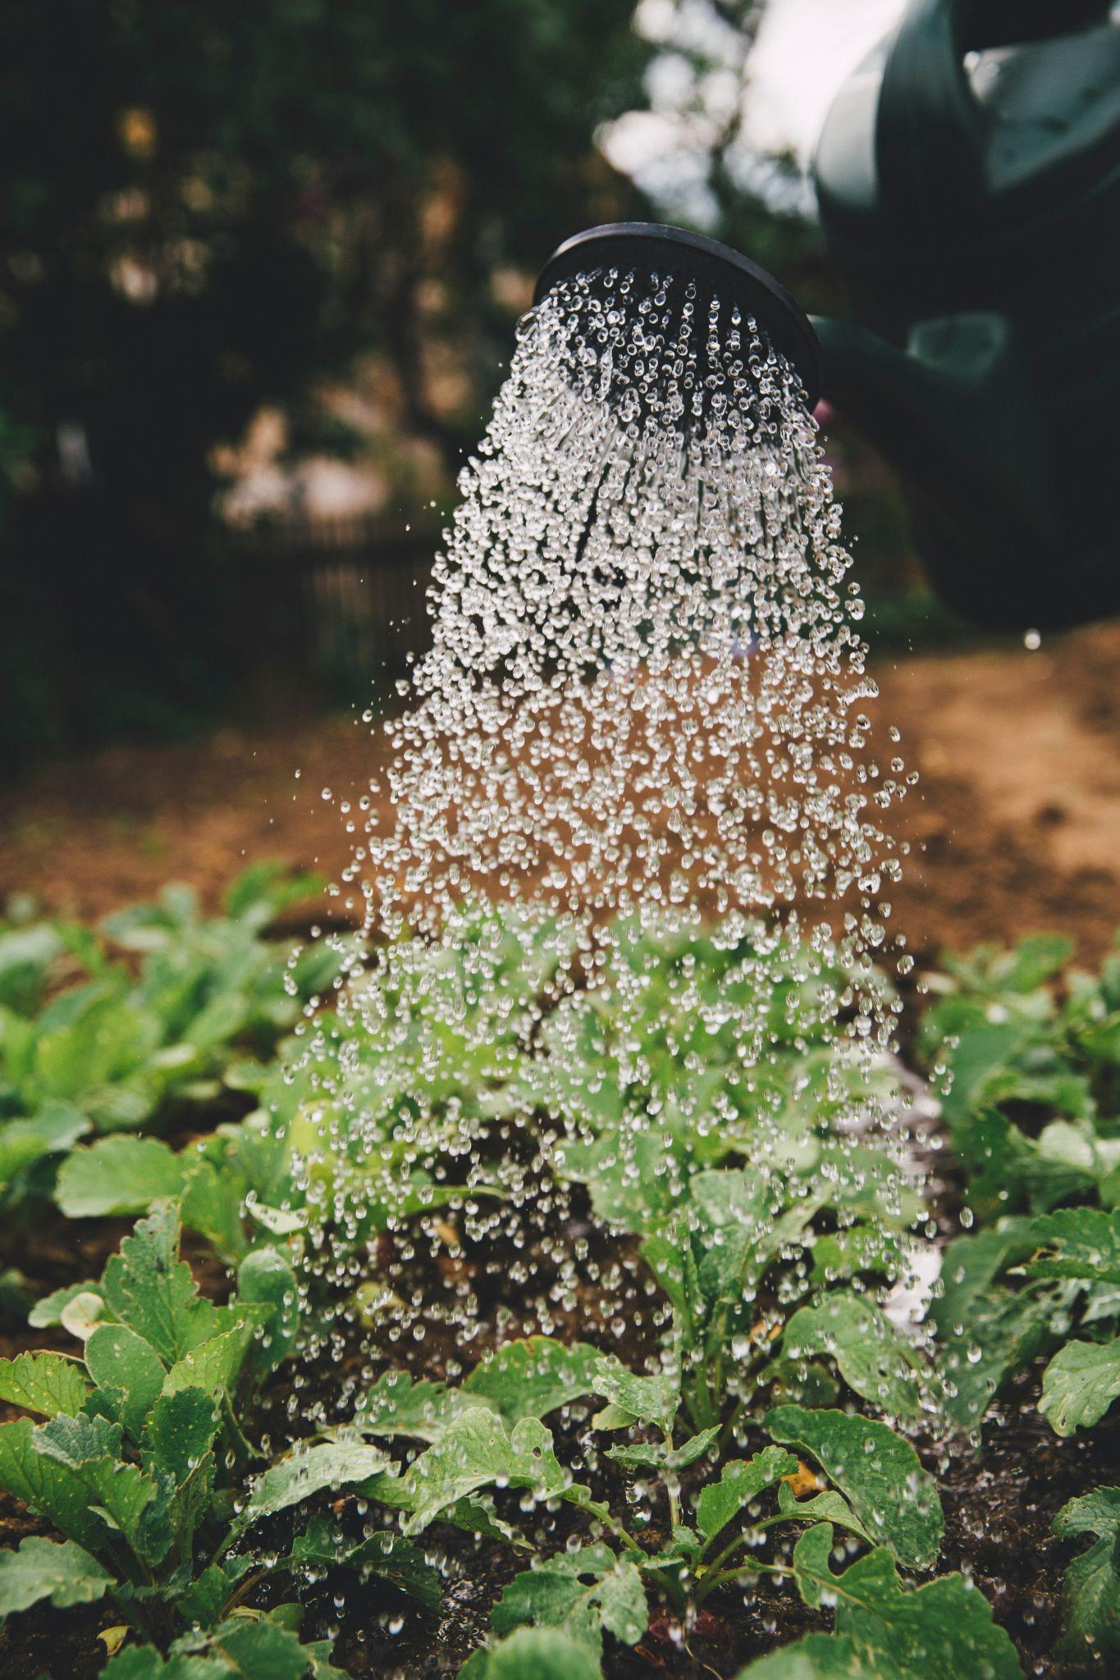
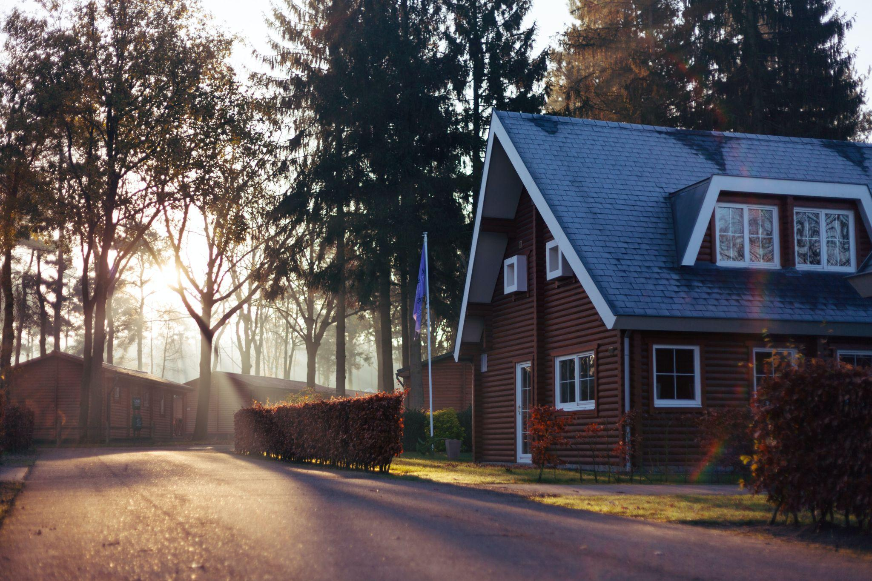
Home Uses, Plus Garden, & Office Units with custom filtration for ultra pure lab use
WaterFaire can provide small offices with their required drinking and wash water as well as manufacturing requirements when back up or clean non mineralized water such as special manufacturing requirements are required. For larger applications a commercial custom unit is an option with daily volumes of 300-500 gallons per day available, or larger based on the site’s requirements. Custom filtrations systems are available as special order options.
WaterFaire can be the sole source for residential water where a family household requires a clean and constant source of drinking and home water for all daily bath, cleaning, and food needs. For potable drinking water a custom filtration plug in device is added.
For gardens and non potable use, WaterFaire water is suitable without added filtration. WaterFaire units can be custom built for ultra pure water requirements in special use cases.
WaterFaire is a solution in droughts, remote locations where no water piping or delivery is available, or polluted regions where the regular water source has become undrinkable, non-potable. Should additional water be required for a large garden or larger family, there are two options: A series installation with two or more WaterFaire units or, The Commercial level unit which produces 100-300 gallons or larger amounts per day on custom order basis. The two requirements are adequate dew point in the atmosphere (usually within 100 to 200 miles of an Ocean or 15-25 miles of a large body of water) and electricity, either through a solar module option or plugged into the main home electric system.

Slide 5
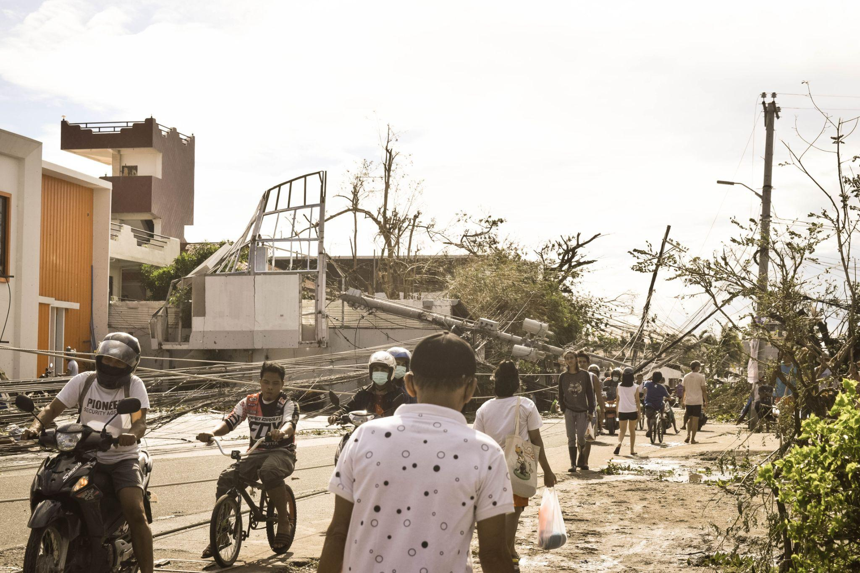
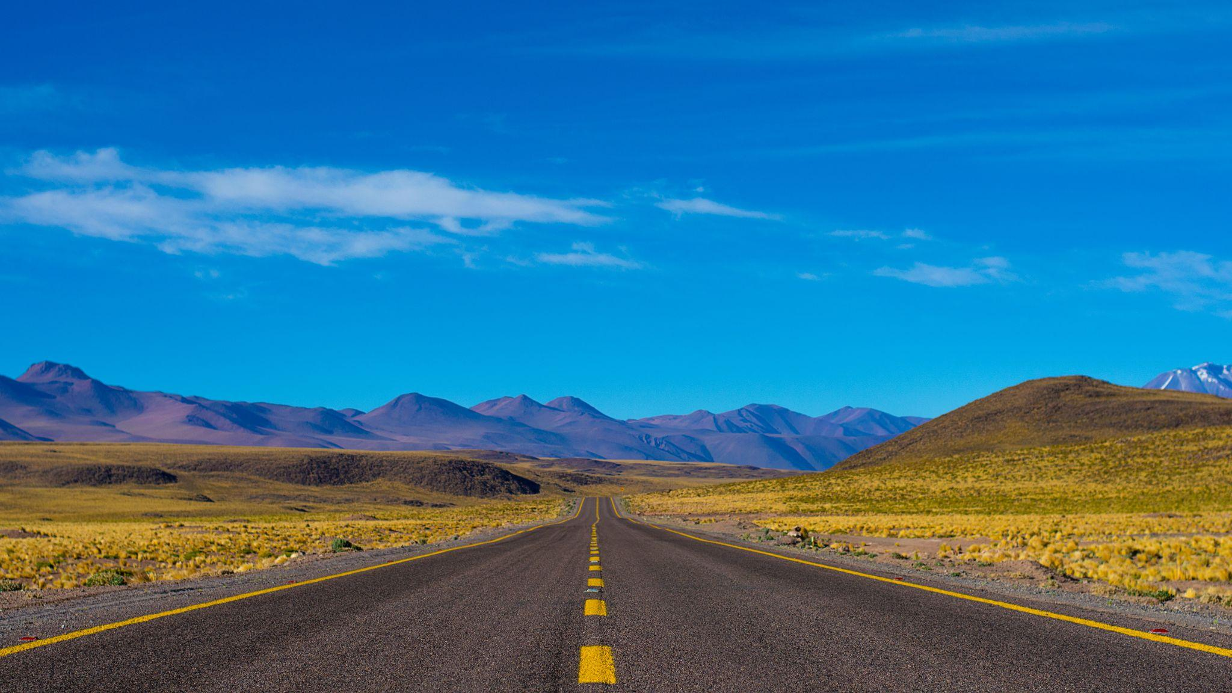
Remote Locations
The essential need for daily fresh water is addressed for global populations located in areas that meet the dew point requirements, including those areas newly subjected to water contamination with released pollutants found often in developed countries. Waterfaire as well opens up opportunities for land use where no surface water is immediately available, including deserts that are located near oceans such as North Africa and the MidEast.
California and other global regions have land where this enables human habitation, crops, and communities with normal life and recreation, otherwise requiring water being transported in.
The combination of solar power with WaterFaire technology is a dual win for remote situations and populations requiring water and power. The basic essential need for daily fresh water is first and foremost the key to be addressed for the global populations. The need for back up in drought prone areas is significant as a water insurance policy. An ongoing daily source of fresh water makes life possible in otherwise uninhabitable regions.

Slide 6
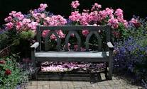
Residential & Commercial Use
Home Use
Home Garden
Full Scale Irrigation
Commercial Nurseries
Tree Farms
Military Deployment
Emergency Centers
Refugee Sites
Start & Go
No Monitoring!
Solar Powered or Hard Wired -
Very SIMPLE to operate! A solution for fractions of a penny per gallon. Water from air technology is a simple, safe and efficient plug and operate model which is completely natural and environmentally friendly

Slide 7
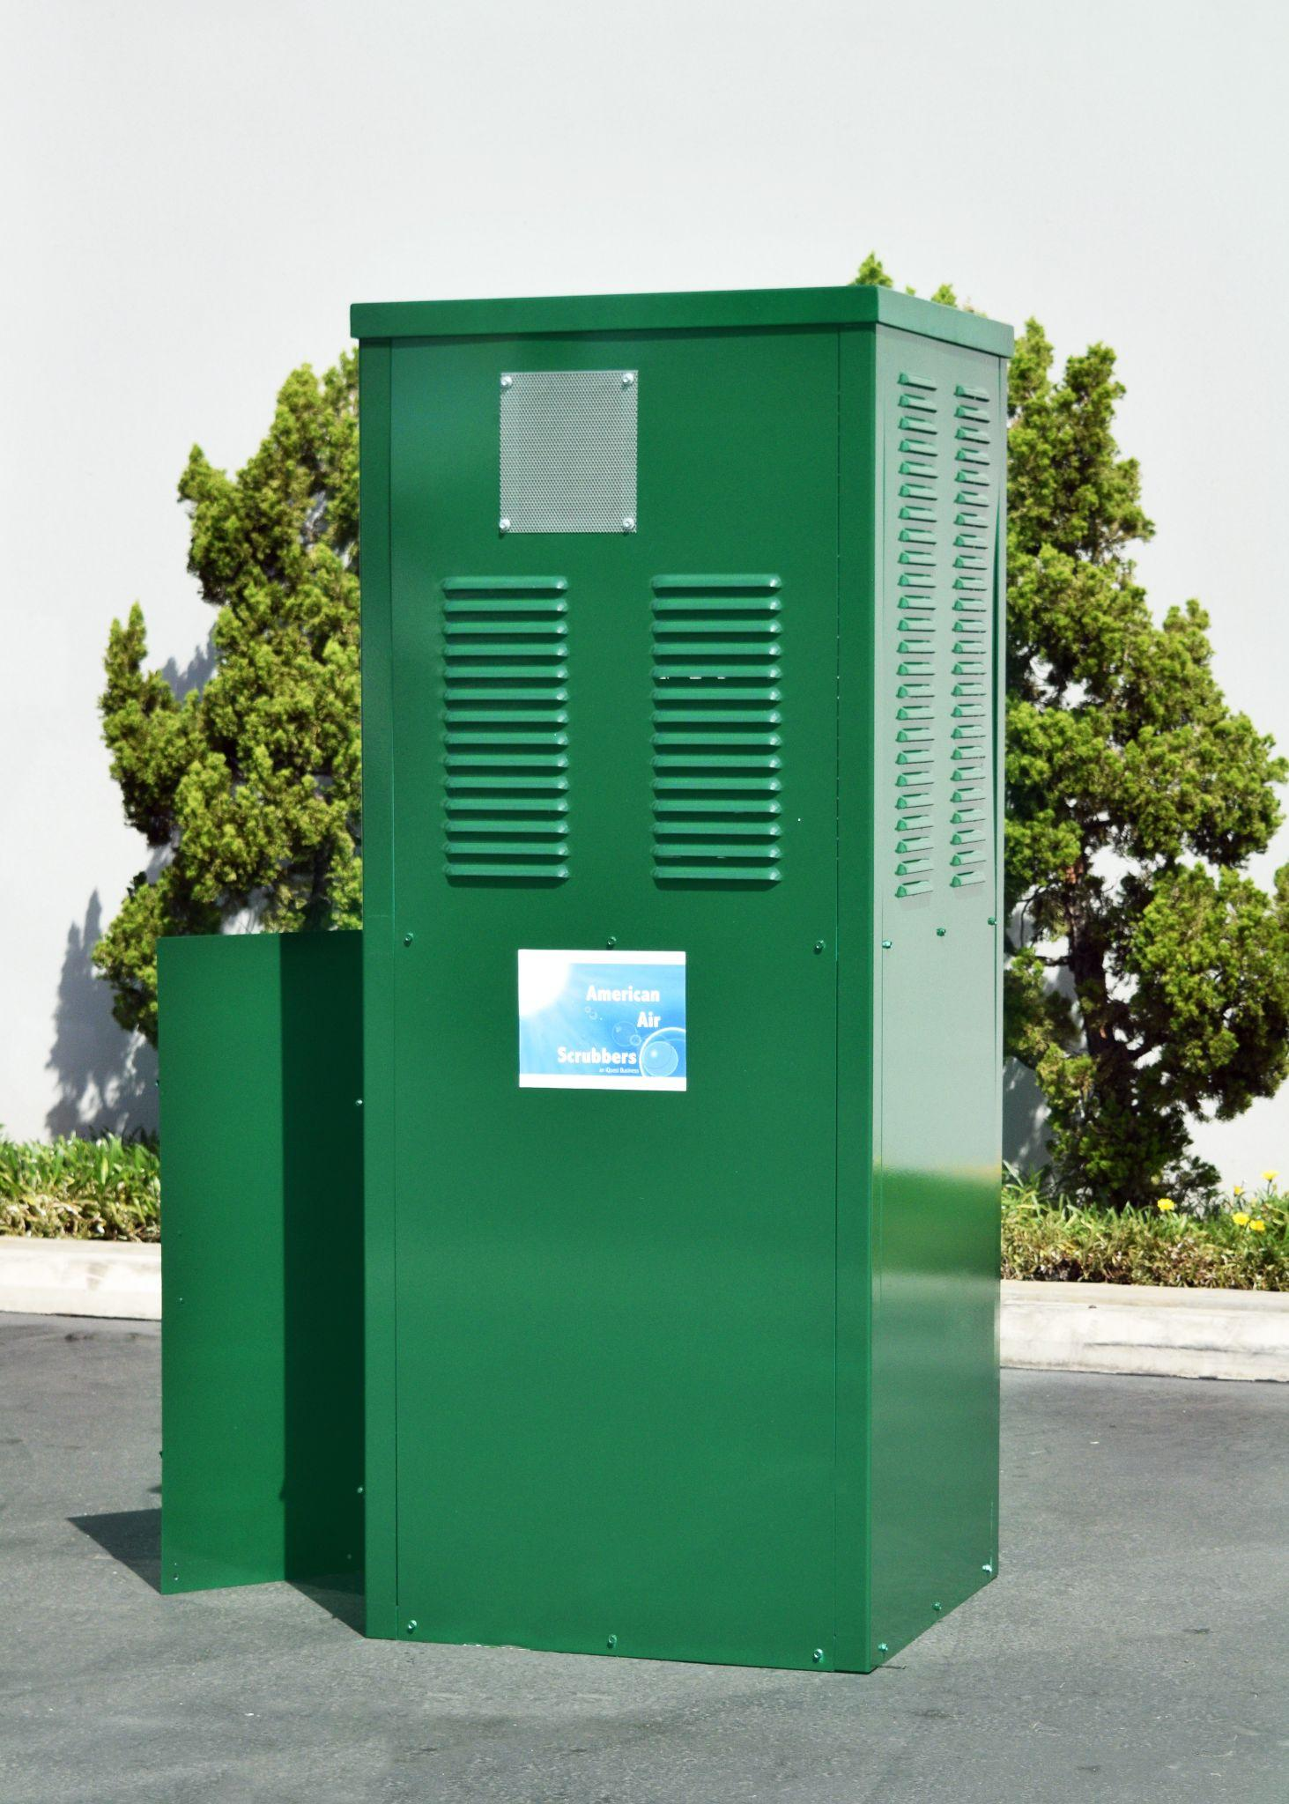
Model Types: Multiple models are available to meet your needs. Standard sizing 20-50 gallons per day and special requests available for systems up to 1,000’s of gallons per day. Footprint varies based on reservoir requested.
WaterFaire HU (Home Unit) 20 – 80 + GPD (Gallons per day)
Home Use
Home Garden
Full Scale Irrigation
Start and Go – No Monitoring!
Solar Powered or Hard Wired
One Button – SIMPLE to Operate
Cost Effective
MSRP, FOB Texas
WaterFaire Industrial UnitCustom Quoted as Ordered
300 -500 GPD (Gallons per day)
Commercial Nurseries or Tree Farms
Military Deployment
Emergency Centers, Refugee Sites
Full Scale Irrigation
Start and Go – No Monitoring!
Solar Powered or Hard Wired
One Button – SIMPLE to operate
Cost Effective
MSRP, FOB Texas

Slide 9
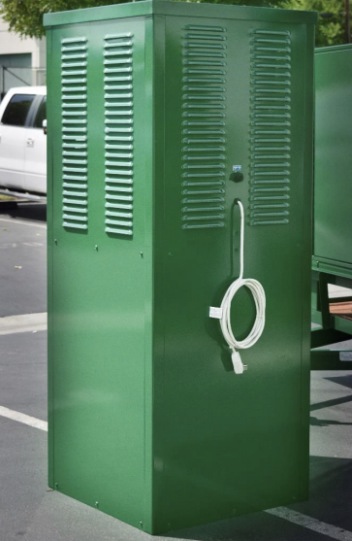
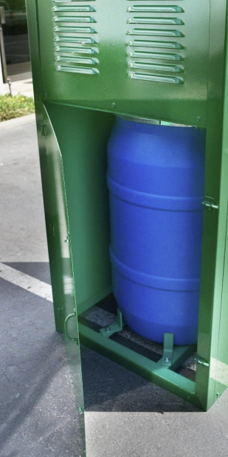
Can run on standard home electricity
When off grid can be
Built in storage & larger external storage
options available
Solar powered

Slide 10
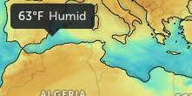
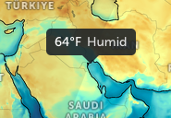
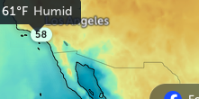
Dew Point vs. Humidity
The dew point is the temperature the air needs to be cooled to (at constant pressure) in order to achieve a relative humidity (RH) of 100%. At this point the air cannot hold more water in the gas form. If the air were to be cooled even more, water vapor would have to come out of the atmosphere in the liquid form, usually as fog or precipitation.
The higher the dew point rises, the greater the amount of moisture in the air. This directly affects how "comfortable" it will feel outside. Many times, relative humidity can be misleading. For example, a temperature of 30 and a dew point of 30 will give you a relative humidity of 100%, but a temperature of 80 and a dew point of 60 produces a relative humidity of 50%. It would feel much more "humid" on the 80 degree day with 50% relative humidity than on the 30 degree day with a 100% relative humidity. This is because of the higher dew point.
So if you want a real judge of just how "dry" or "humid" it will feel outside, look at the dew point instead of the RH. The higher the dew point, the muggier it will feel.
Waterfaire operates most efficiently in areas near the ocean or large body of water where the combination of relative humidity, dew point, and temperature all relate to the amount of water in the air and Water Faire's successful capturing the atmospheric moisture.
Earth Dew Points : Click to search global areas

Slide 11
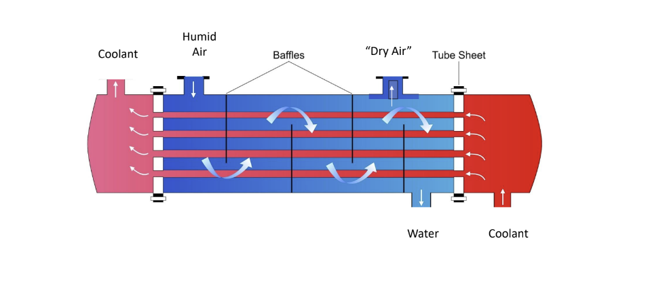
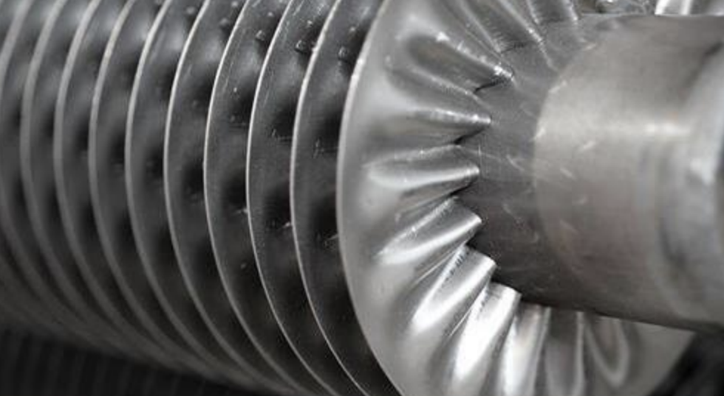
Atmospheric Condenser
The adjacent drawing to the left shows the components and order of the WaterFaire process
This bladed item to the right is a compressor component WaterFaire uses in the above designed process to maximize water capture efficiency.

Slide 12
Smart Water Solutions for Drought Stricken Lawns & Gardens
Is the drought killing your flowers, vegetable garden and lawn?
There is a simple, reliable solution for fractions of a penny per gallon
Like morning dew, extract water from the atmosphere
Completely natural and environmentally friendly
On-demand or continuous operation
Comes with distributive drip lines for your garden, flowers, vegetables, lawns and fountains
Multiple Models Available to Meet Your Needs
Standard sizing 20 - 100 gallons per day
Special request available for systems up to 1,000’s of gallons per day
Footprint varies based on reservoir requested
Power Options
110V
Solar Panel
Stored Energy for 24/7 Operations
Efficient | Simple | Safe | Plug and Operate

Slide 13
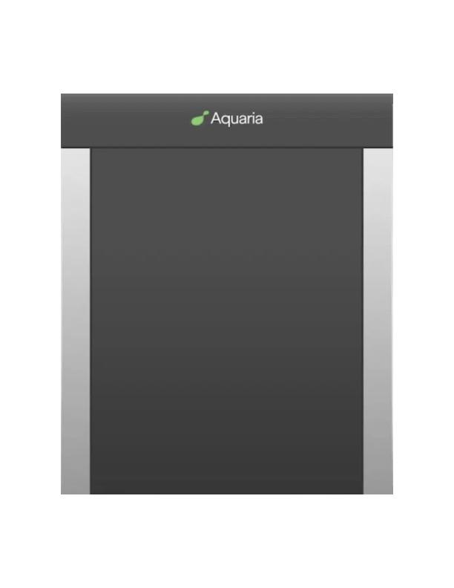
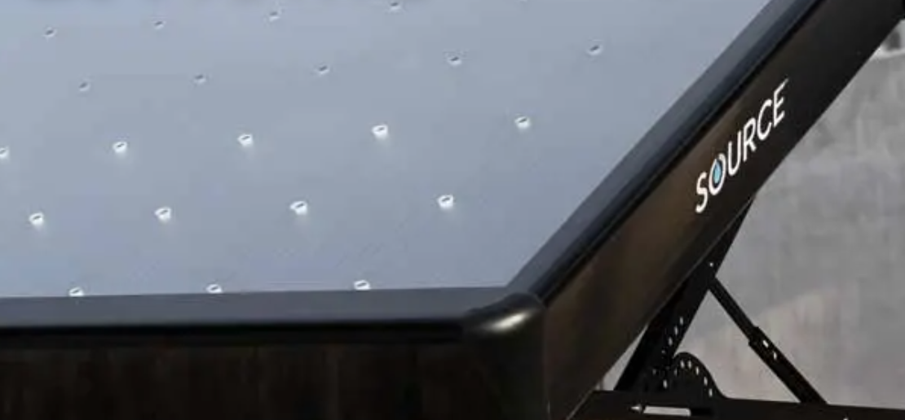
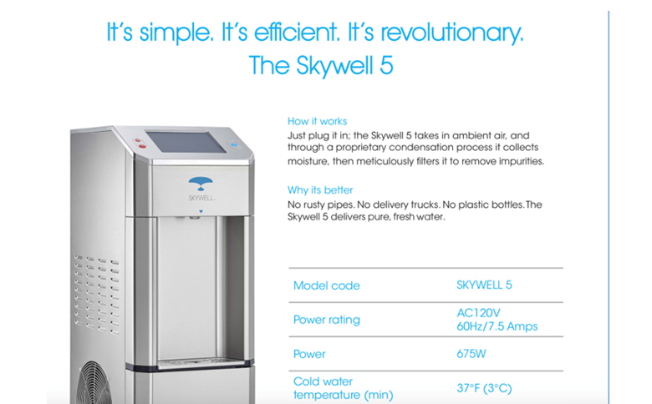
Competitive Landscape shows WaterFaire is lower in cost, higher in GPD yield throughput
www.Source.co: Solar-driven, grid-free, pristine water. Unleash the power of SOURCE® Hydropanels™. Pure water from air + sunlight. Say goodbye to grid dependency with Hydropanels™.
Cost is $2950. Claims daily production is 6 bottles of 16.9 oz per day. (Less than 1 GPD, which is 128 fluid ounces)
*First panel including tank, home connection kit & warranty. One (1) Hydropanel produces up to 6 bottles of water per day (16.9 oz bottles). Solar and environmental conditions will cause variations in production. For more information see our FAQ page. †16.9 oz bottles. ❂10% of our net proceeds are used to improve water access worldwide.
www.Aquaria.co Hydropixel
Regular price $3,699.00
Operating Range - ≥60°C / Humidity ≥25% RH Water Tank: 52L / 14Gal (internal storage tank) Dispensing Options: Cold Water Operation Sound Level: ≤58Db Power Supply: 110V (220V available upon inquiry) Operating Power: 1250W Frequency: 50Hz
Skywell.com: https://tinyurl.com/kkxx79ws
Skywell does offer a larger atmospheric water generator capable of producing 100 gallons of drinkable water per day. But the unit costs $28,000, more than 10 times the smaller unit.

Slide 19
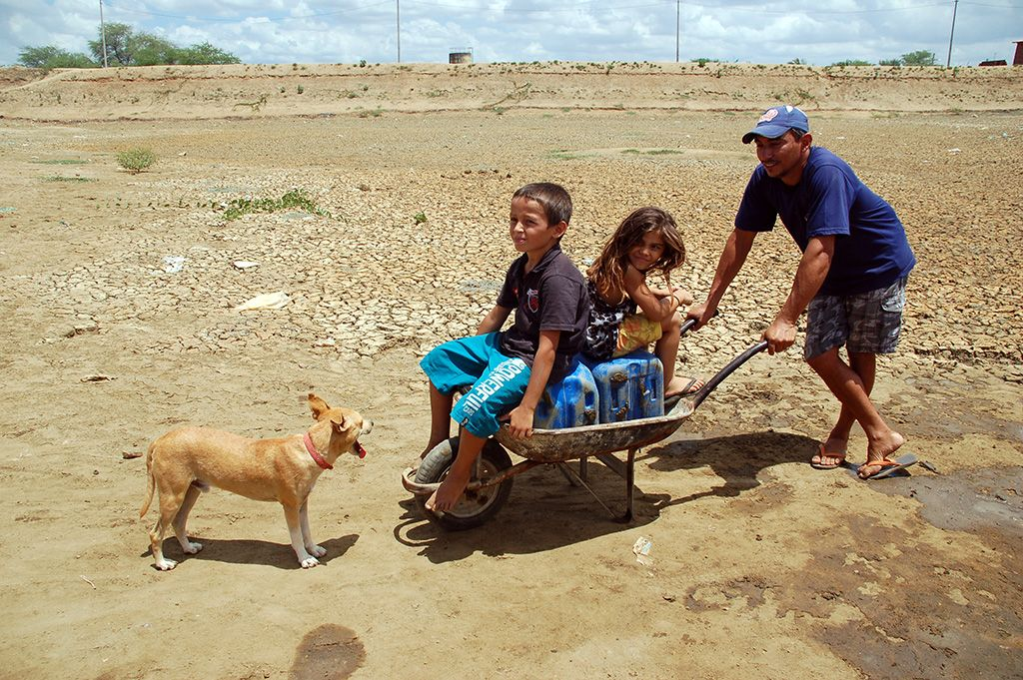
Bringing Water to Local Communities.
For Ordering, Further Information, and Distributor Applications:
Call 1-800-4 FUTURE
or email orders@coretechdev.com

